Slide 1
Logistical and decontamination issues
CGPRT(W) : Ensuring Clean Seas and Coasts in Western Region ……

Slide 2
Objective
To understand the importance of the logistics supply chain, equipment staging and decontamination.
CGPRT(W) : Ensuring Clean Seas and Coasts in Western Region ……

Slide 3
Logistics
Provides the equipment and services allowing the response effort to function on a daily basis
The supply chain that logistics maintains keeps the spill response operations functioning
CGPRT(W) : Ensuring Clean Seas and Coasts in Western Region ……

Slide 4
Logistics
Responsible for:
  Communications
  Medical support to incident personnel
  Food for incident personnel
  Supplies
  Facilities
  Ground support
CGPRT(W) : Ensuring Clean Seas and Coasts in Western Region ……

Slide 5
Supply Chain
  Medical
  Provides first aid and light medical treatment services and equipment
CGPRT(W) : Ensuring Clean Seas and Coasts in Western Region ……

Slide 6
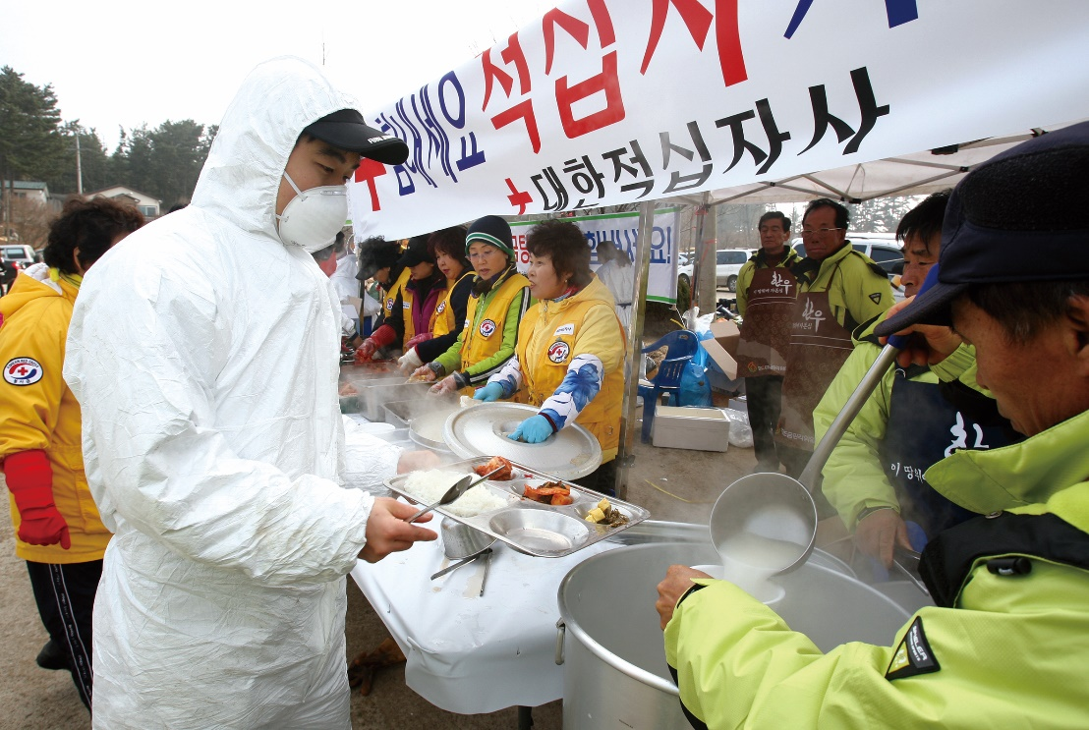
Supply Chain
  Food
  Supplies the food and potable water
  Obtains equipment and supplies to operate food service facilities
CGPRT(W) : Ensuring Clean Seas and Coasts in Western Region ……

Slide 7
Supply Chain
  Supply
  Assists in determining the type and amount of supplies needed to support the incident
  Orders, receives, stores, and distributes supplies
  Services equipment
  Places all resource orders
  Maintains inventory of supplies and equipment
CGPRT(W) : Ensuring Clean Seas and Coasts in Western Region ……

Slide 8
Supply Chain − Support Branch
  Facilities unit
  Sets up and maintains facilities
  Provides managers for base and camps
  Provides facility security and maintenance services (sanitation, lighting, clean-up, decontamination supplies)
CGPRT(W) : Ensuring Clean Seas and Coasts in Western Region ……

Slide 9
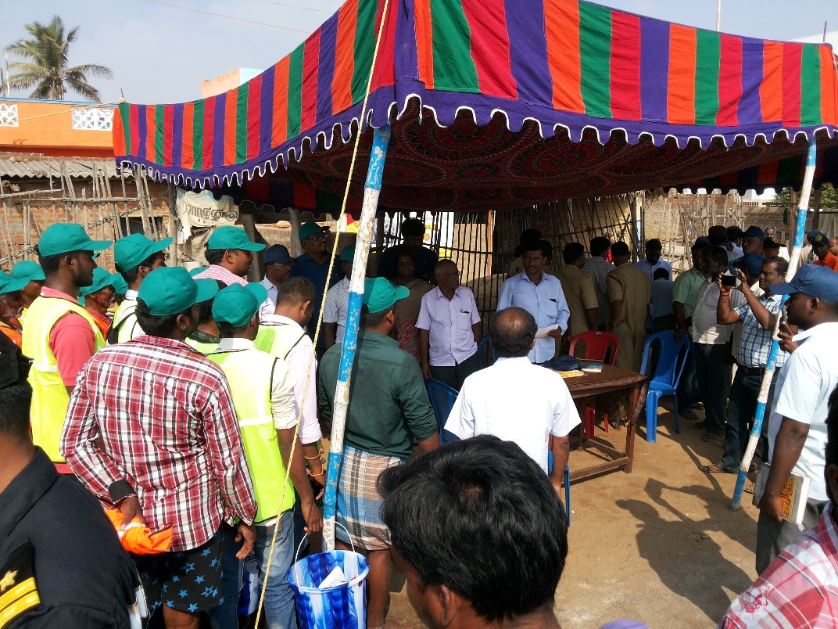
Supply Chain
  Ground Support
  Arranges for and documents the fueling and maintenance of ground resources
  Arranges for transportation of personnel, supplies, food and equipment
CGPRT(W) : Ensuring Clean Seas and Coasts in Western Region ……

Slide 10
Supply Chain
Logistics ensures that the proper supplies and equipment are available
This is a major task and must be done in order for operations to begin
  Example: Personnel need PPE before work can begin
  Example: Vessels need to refuel regularly to continue operations
  Example: Operations needs boom and all related boom accessories
CGPRT(W) : Ensuring Clean Seas and Coasts in Western Region ……

Slide 11
Staging Area
Temporary location where equipment, personnel and other resources are staged while waiting for tactical assignments
Strategically located to supply the response operations
Typically close to response operations (may be limited by access to property, physical geography, etc.)
CGPRT(W) : Ensuring Clean Seas and Coasts in Western Region ……

Slide 12
Staging Area
Requires a large, flat area with access for equipment such as boats, heavy machinery, spill equipment, rest facilities, parking area, etc.
CGPRT(W) : Ensuring Clean Seas and Coasts in Western Region ……

Slide 13
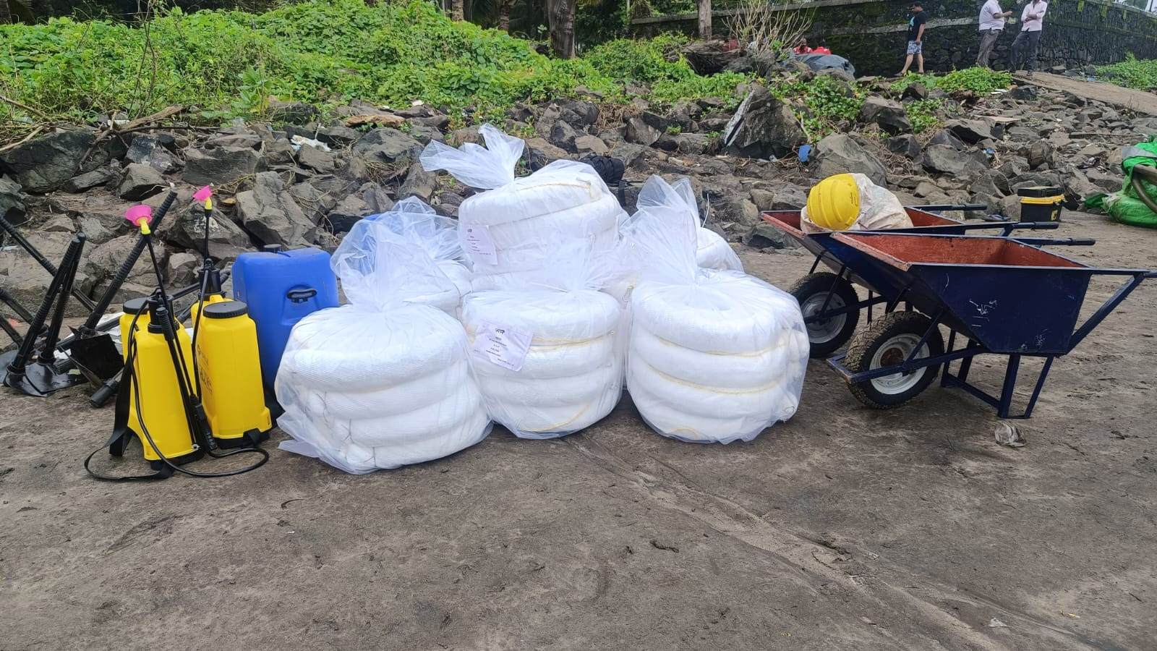
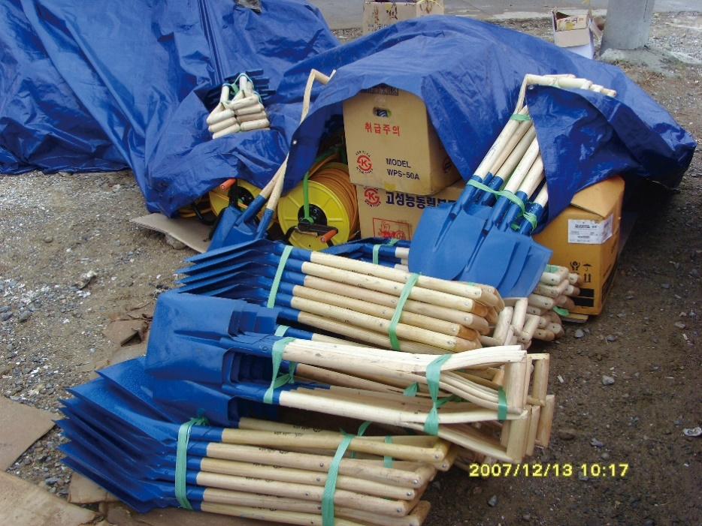
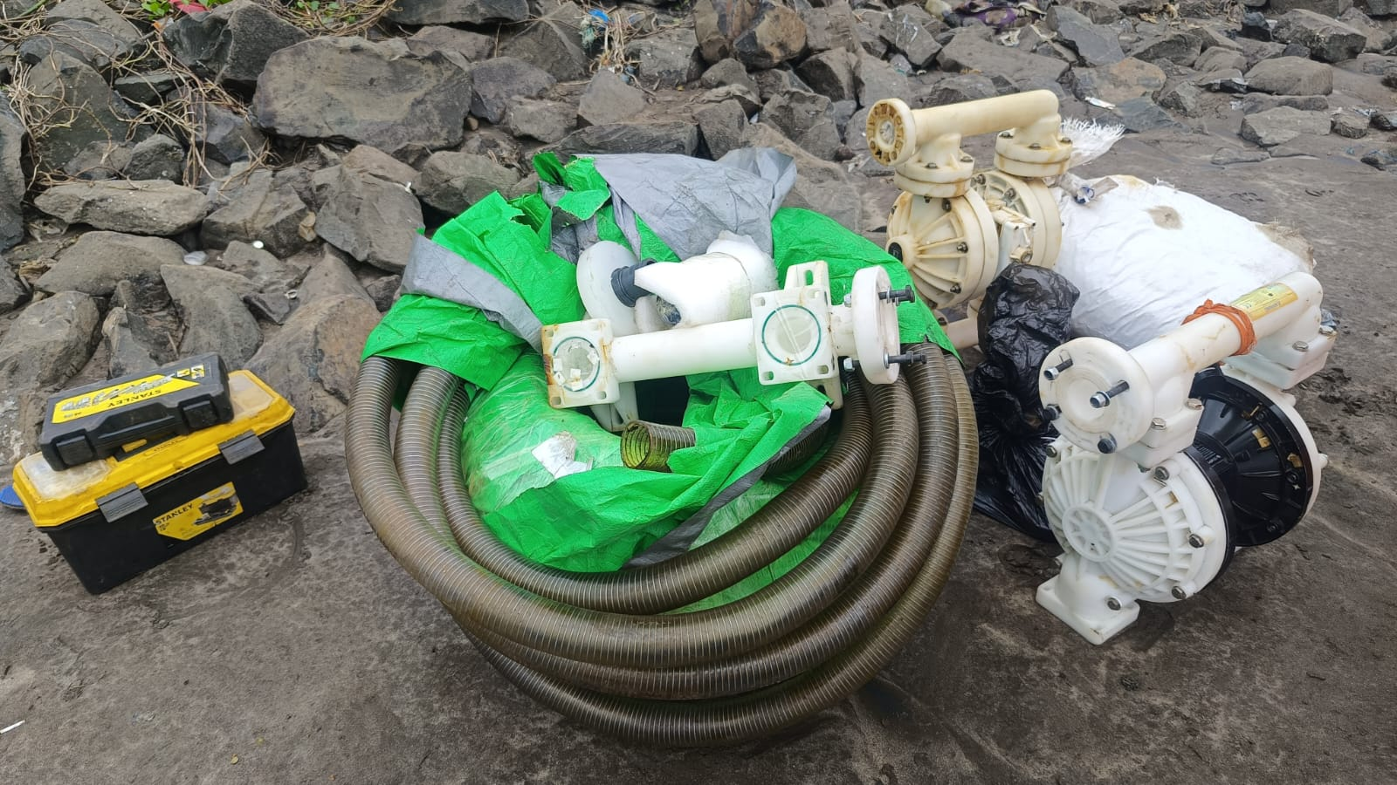
Staging
CGPRT(W) : Ensuring Clean Seas and Coasts in Western Region ……

Slide 14
Decontamination
Part of the health and safety plan
Critical for the health and safety of response personnel
Critical to avoid secondary contamination by response personnel or other spill vehicles and vessels
Logistics procures the decon supplies and equipment
CGPRT(W) : Ensuring Clean Seas and Coasts in Western Region ……

Slide 15
Decontamination
  Personnel
  Vessels
  Vehicles i.e. trucks, ATVs
  Heavy equipment
  Spill equipment
    Skimmers
    Boom
    Pumps/hoses
    Storage tanks
CGPRT(W) : Ensuring Clean Seas and Coasts in Western Region ……

Slide 16
Decon Plan
Description and location of decon facilities
List of decon equipment required
PPE for the personnel doing the decon
Decon procedures for specific materials
Procedures to prevent secondary contamination
Procedures fo prevent secondary contamination for personnel removing oiled PPE
CGPRT(W) : Ensuring Clean Seas and Coasts in Western Region ……

Slide 17
Decon Plan
Safe disposal methods for various materials that cannot be decontaminated, i.e. disposable coveralls, gloves, sorbents
Revisions for changes in site conditions
CGPRT(W) : Ensuring Clean Seas and Coasts in Western Region ……

Slide 18
Decon facilities
Decon should be done in stages, moving either from a cold zone (clean, support), through a warm zone (contamination) to a hot zone (exclusion) or vice versa
Hot Warm Cold
CGPRT(W) : Ensuring Clean Seas and Coasts in Western Region ……

Slide 19
Decon − Personnel
Decon facilities set up for responders
  Remove oiled PPE in a controlled environment
  Washing facilities
  Storage facilities for cleaned PPE and clean clothing
  Waste facilities for disposable PPE
Proper decon facilities for PPE means it stays in good condition longer, is more cost-effective and reduces strain on the supply chain
CGPRT(W) : Ensuring Clean Seas and Coasts in Western Region ……

Slide 20
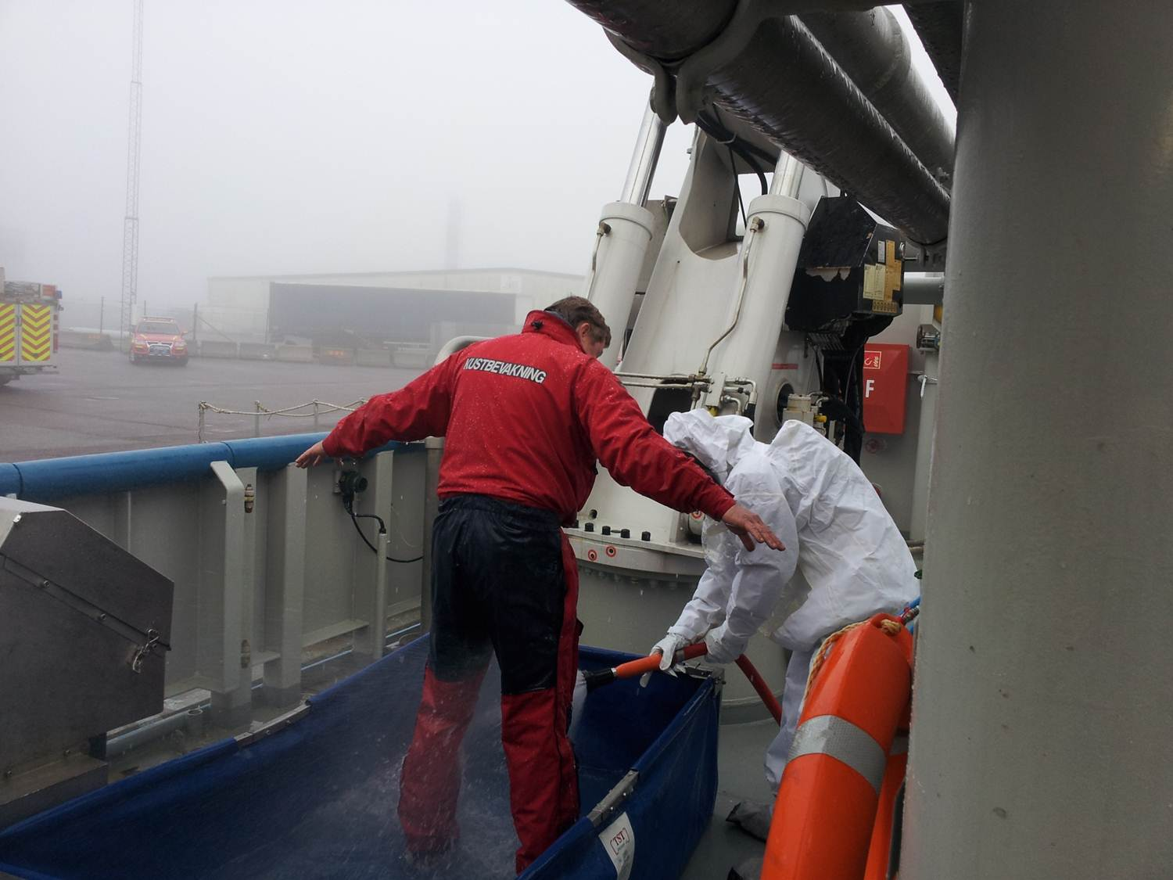
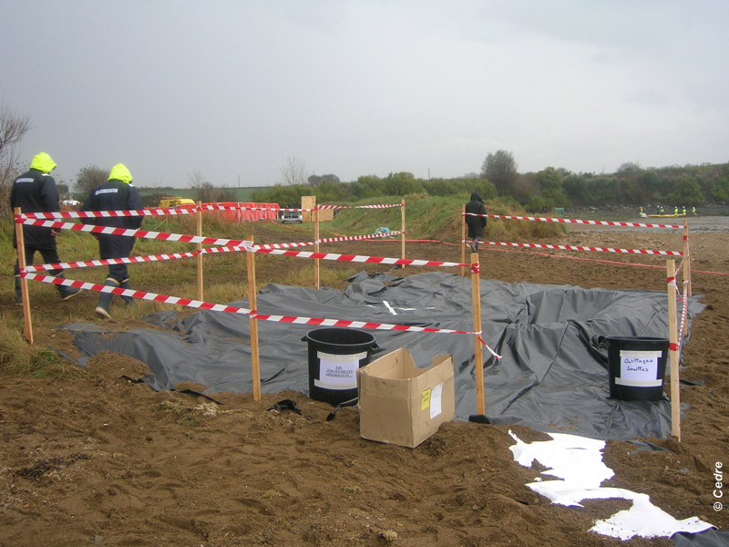
Decon Facilities
CGPRT(W) : Ensuring Clean Seas and Coasts in Western Region ……

Slide 21
Decon − Personnel
Avoid contamination contact
Practice good hygiene and decontamination procedures
Understand the product (Safety data sheet) and use PPE appropriately
CGPRT(W) : Ensuring Clean Seas and Coasts in Western Region ……

Slide 22
Decon − Personnel
Important for personnel to use proper PPE and decon procedures to avoid:
  Inhalation − Respiratory protection during initial response (vapours) and while pressure washing (mists)
  Ingestion − Wash up prior to eating and drinking (smoking)
  Aspiration − Fall into product and or during mist generation
  Absorption − Direct skin contact usually through improper glove sleeve interface
CGPRT(W) : Ensuring Clean Seas and Coasts in Western Region ……

Slide 23
Vehicles and Heavy Equipment
Important to avoid secondary contamination by vehicles
Transport cleaning stations need to be set up to prevent oil from being transferred to roads or other public places
A lined containment area where vehicles can drive onto and be cleaned, including tyres
CGPRT(W) : Ensuring Clean Seas and Coasts in Western Region ……

Slide 24
Vessels
Oiled vessels must be kept in a “hot” area during spill operations that should be boomed to prevent contamination of clean areas
Boom gates can be used to allow vessels to move between boomed areas
Vessels must be decontaminated when ready to demobilize or moved vessel to another location
CGPRT(W) : Ensuring Clean Seas and Coasts in Western Region ……

Slide 25
Vessels
Vessel washing stations can be set up with lined containment areas to clean hull and decks
Oily wash water must be contained and collected
CGPRT(W) : Ensuring Clean Seas and Coasts in Western Region ……

Slide 26
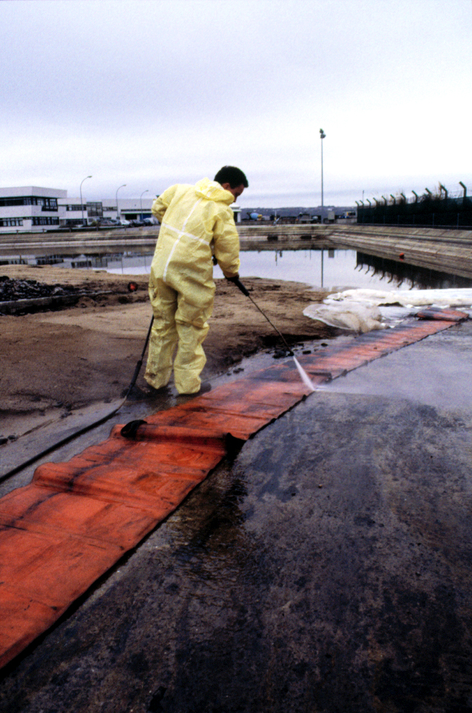
Equipment Decon
Source: CEDRE
CGPRT(W) : Ensuring Clean Seas and Coasts in Western Region ……

Slide 27
Conclusions
Logistics is critical to the response effort
The supply chain must be maintained to avoid “bottlenecks” − even small breaks in this chain can suspend operations, e.g. fuel or drinking water
Staging and decontamination facilities are required immediately to allow personnel to safely leave the spill site and to maintain equipment
CGPRT(W) : Ensuring Clean Seas and Coasts in Western Region ……

Slide 28
Any questions?
CGPRT(W) : Ensuring Clean Seas and Coasts in Western Region ……

